Slide 1


GIT & GITHUB

Slide 2
GIT & GITHUB
Version control system
Centralized version control system
Distributed version control system
Difference between DVCS & CVCS
What is Git
What is GitHub
Difference Git & GitHub
Working with commands

Slide 3
VERSION CONTROL SYSTEM
Early management collaboration on a project by avoiding frustration of swapping
Ability to have unlimited number of developers working on the same code base
Easily revert back your files if something happened
There are two main categories of version control system
1. Centralized version control system
2. Distributed version control system

Slide 4
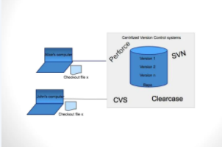
CENTRALIZED VERSION CONTROL SYSTEM
Single server contains all versioned files.
Clients check out files from the central
place, and all changes pushed to server
Has been standard for many years
Disadvantages:
Slow
No redundancy
If server goes down ,
no local tracking of files

Slide 5
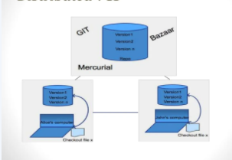
DISTRIBUTED VERSION CONTROL SYSTEM
Clients fully mirror the repository
Redundant
All clients have entire history
Easier collaboration
Multiple workflows
faster

Slide 6
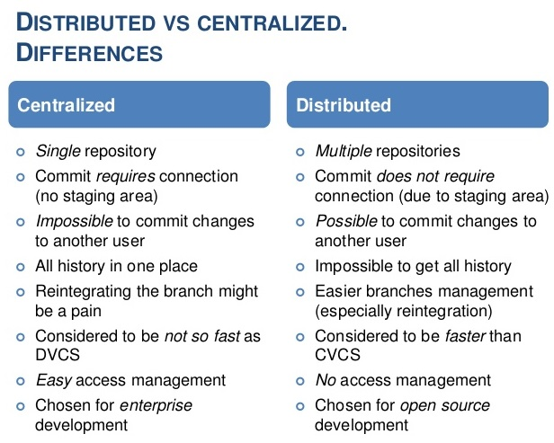

Slide 7
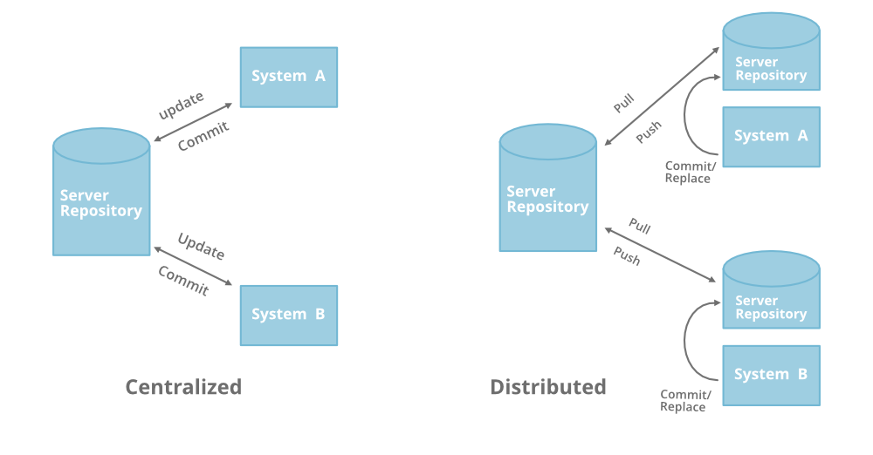
CENTRALIZED VCS Vs DISTRIBUTED VCS

Slide 8
WHAT IS GIT
Git is a Version Control System (VCS) designed to make it easier to have multiple versions of a code base, sometimes across multiple developers or teams
It allows you to see changes you make to your code and easily revert them.
Git helps you keep track of code changes.
Git is used to collaborate on code.
It is NOT GITHUB!

Slide 9
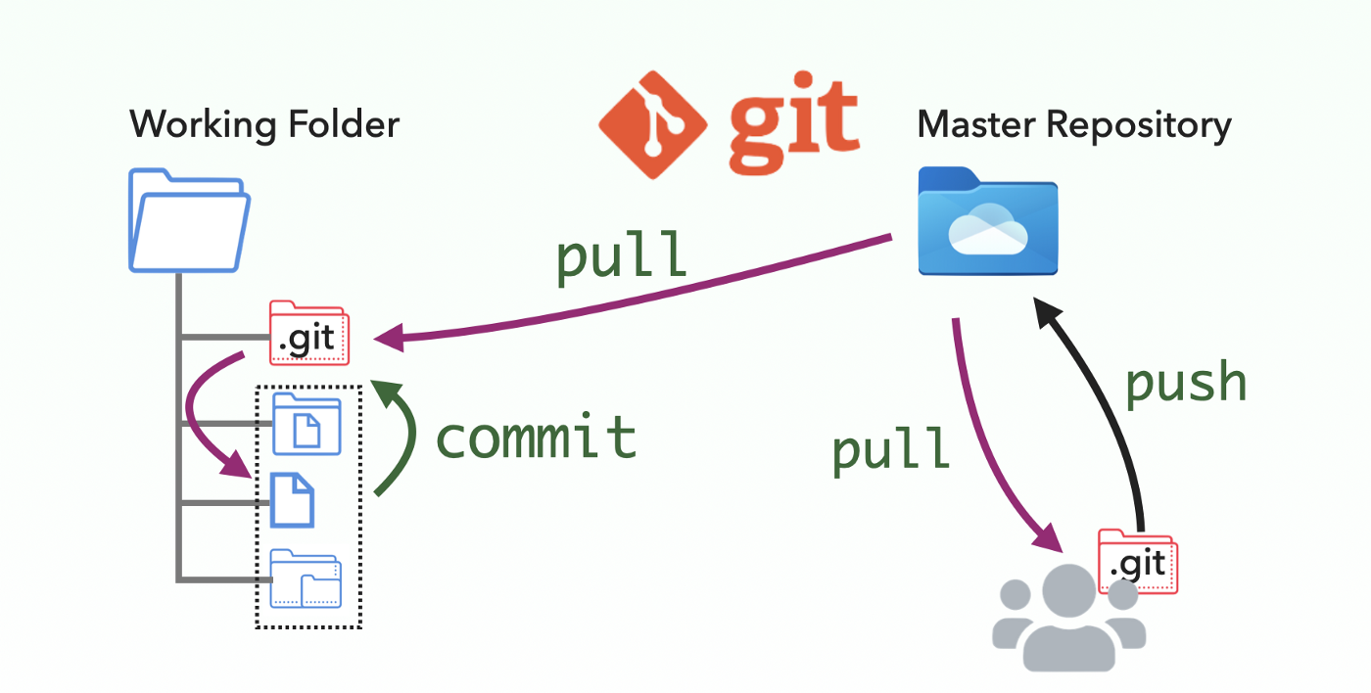
GIT VERSION CONTROL SYSTEM

Slide 10
WHAT IS GITHUB
Github.com is a website that hosts git repositories on a remote server
Hosting repositories on Github facilitates the sharing of codebases among teams by providing a GUI to easily fork or clone repos to a local machine
By pushing your repositories to Github, you will pretty much automatically create your own developer portfolio as well!

Slide 11
DIFFERENCE BETWEEN GIT & GITHUB
S.No | Git | GitHub
1 | It is a software | It is a service
2 | It is installed locally on the system | It is hosted on web
3 | It is a command locally on the system | It provides a graphical interface
4 | It is a tool to manage different versions of edits made to files in a git repository | It is a space to upload a copy of the git repository
5 | It provides functionalities like Version Control System source code management | It provides functionalities of GIT like VCS Sources Code Management as well as adding few of its own features

Slide 12
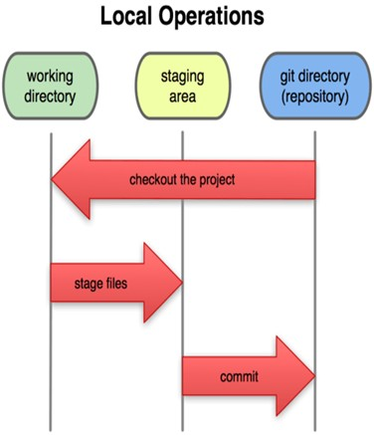
WORKFLOW OF GIT
Three main states of a Git:
Working Directory – local disk
where the changes are done
Staging Area – a file containing information about what will go into next commit
Git Directory –stores metadata and
Object database for the project
while cloning the repository

Slide 13
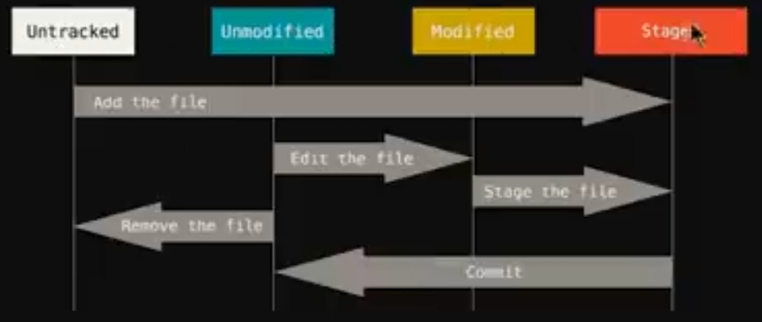

Slide 14
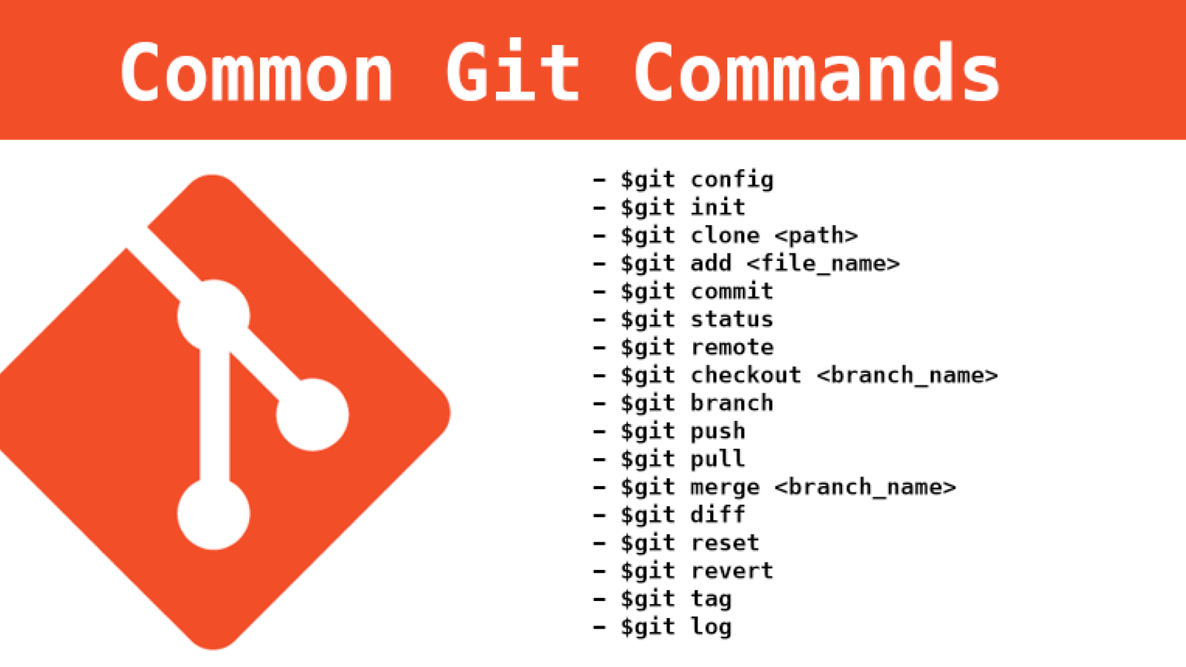
WORKING WITH GIT & GITHUB

Slide 15
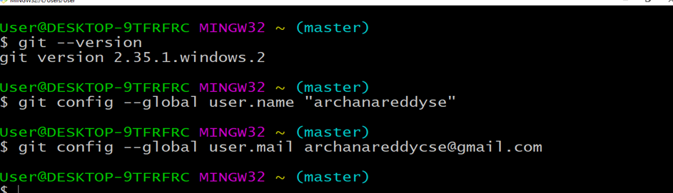
INRODUCE YOURSELF TO GIT
Git init :
git config --global user.name “USER NAME"
git config --global user.email USER@MAILID
You only need to do this once
If you want to use a different name/email address for a particular project, you can change it for just that project
cd to the project directory
Use the above commands, but leave out the –global

Slide 16
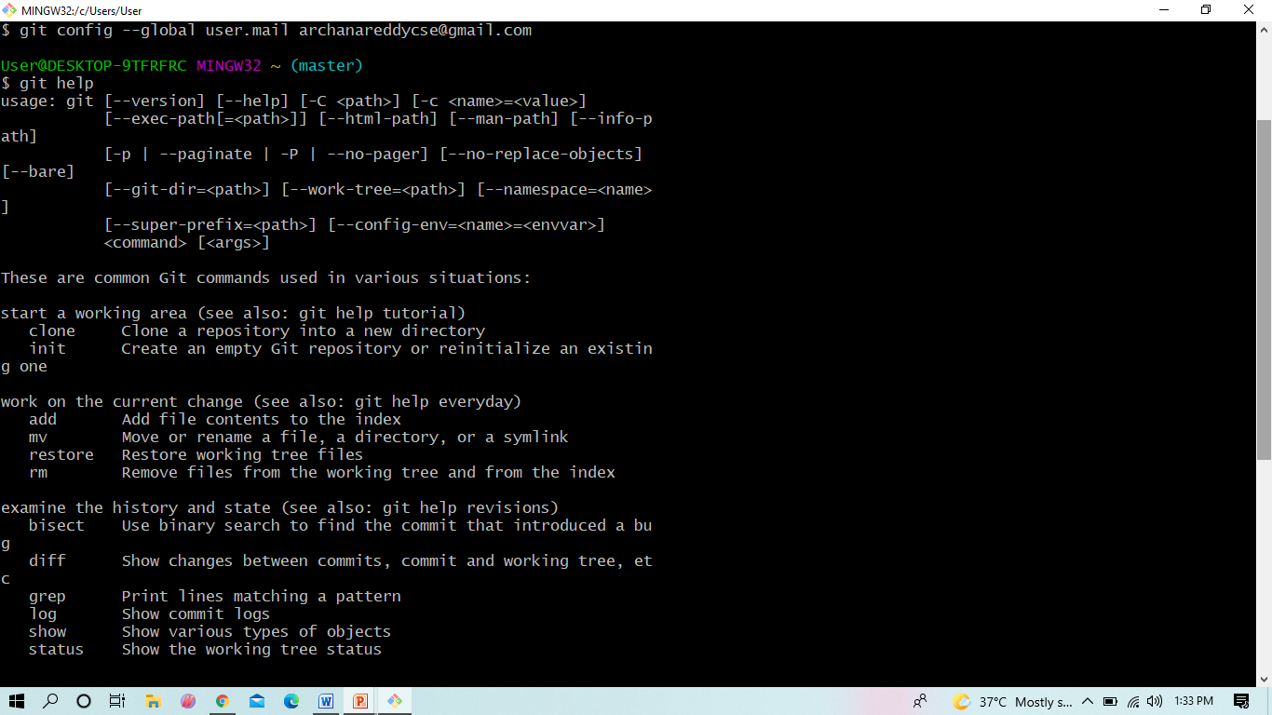
GIT HELPS YOU

Slide 17
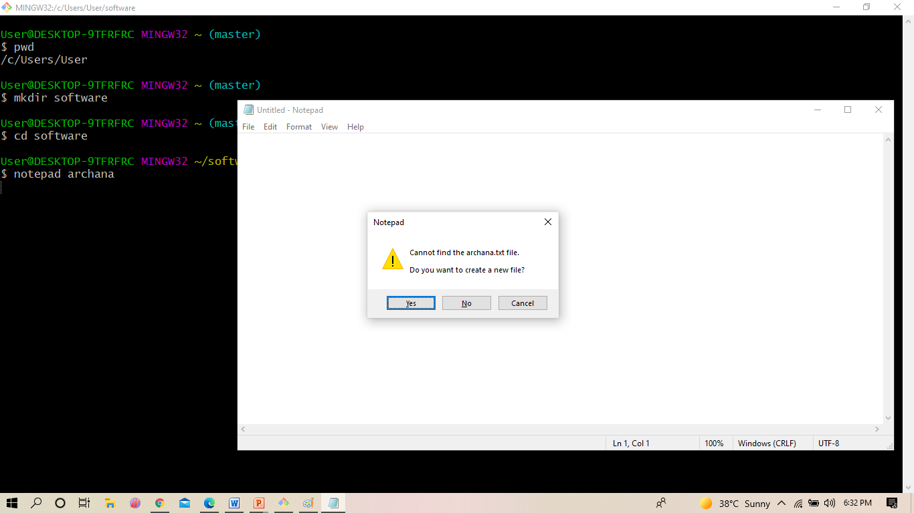
WORKING WITH GIT
$ pwd : present working directory
$ mkdir : creating the directory
$cd : getting into that directory
$ notepad filenme : creating the file

Slide 18
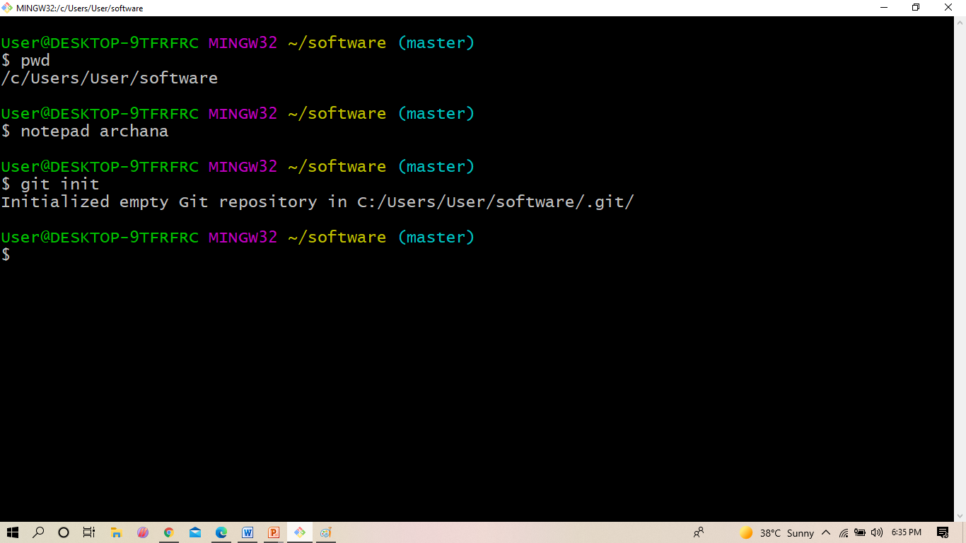
WORKING WITH GIT
$ git init : The git init command creates a new Git repository

Slide 19
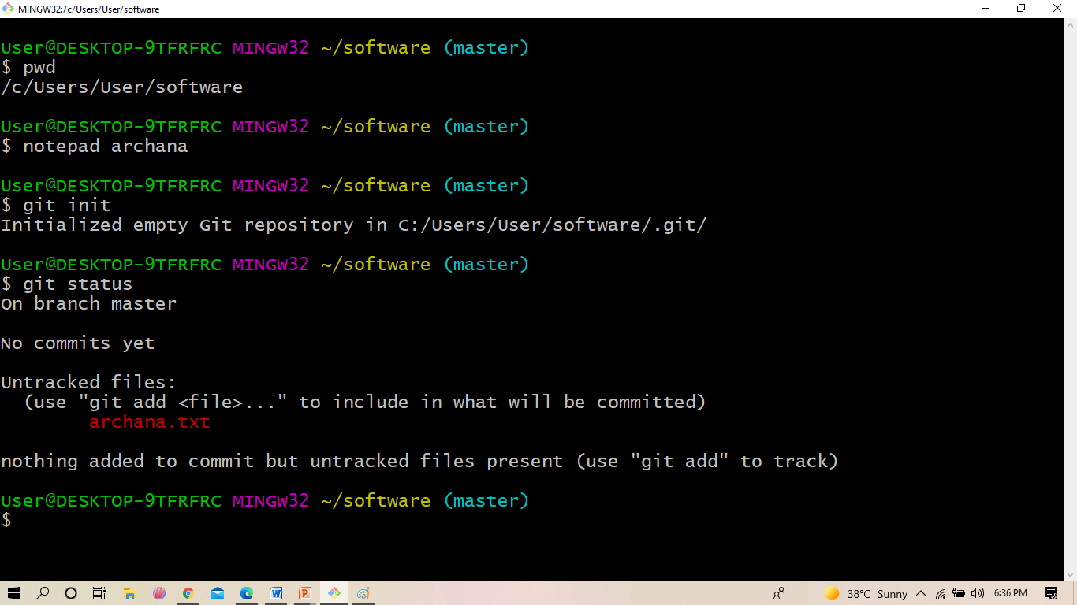
WORKING WITH GIT
$ git status :
The git status command displays the state of the working directory and the staging area

Slide 20
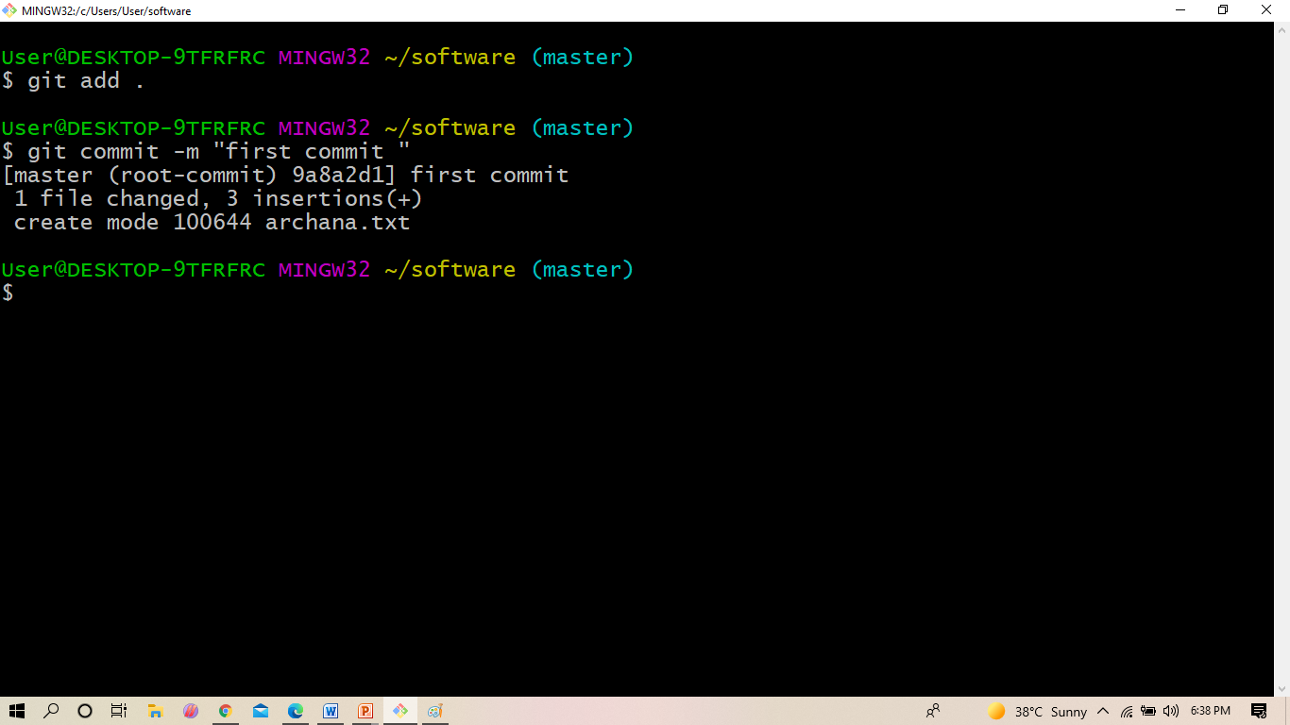
WORKING WITH GIT
$ git commit -m “meaningful mesage must
The git commit command captures a snapshot of the project's currently staged
changes. Committed snapshots can be thought of as “safe” versions of a project—Git will never change them unless you explicitly ask it to.

Slide 21
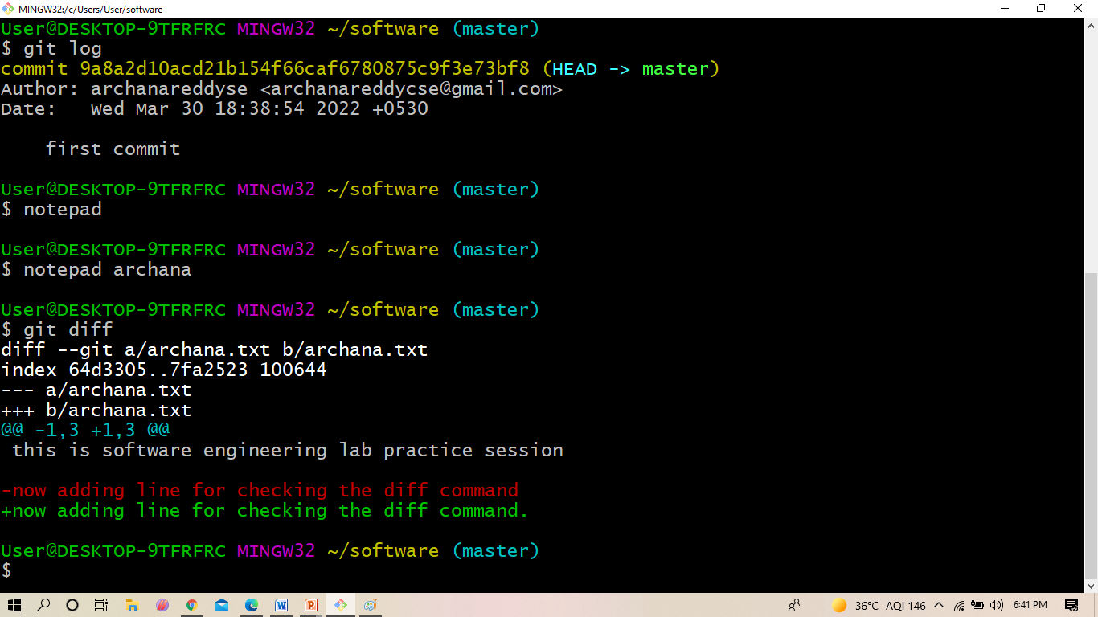
WORKING WITH GIT
$ git diff
It is used to show changes between working tree and staged
$git diff –staged shows changes between staged and commit

Slide 22
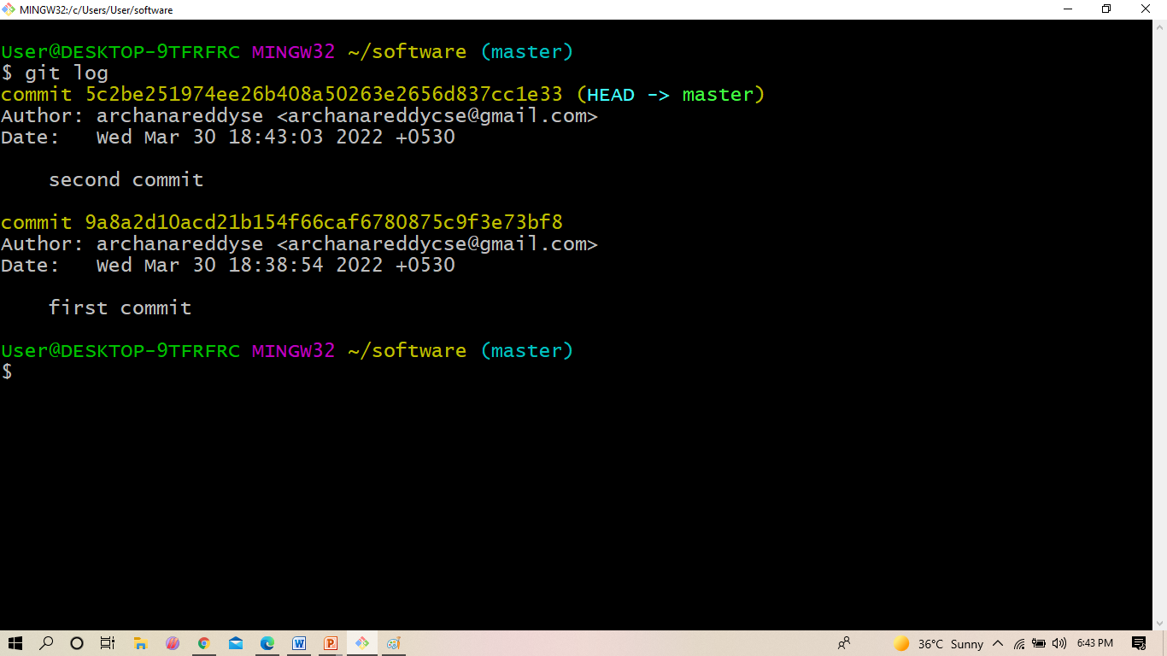
WORKING WITH GIT
$ git log :
The git log command displays all of the commits in a repository's history.
By default, the command displays each commit's: Secure Hash Algorithm (SHA) code, author, and date.

Slide 23
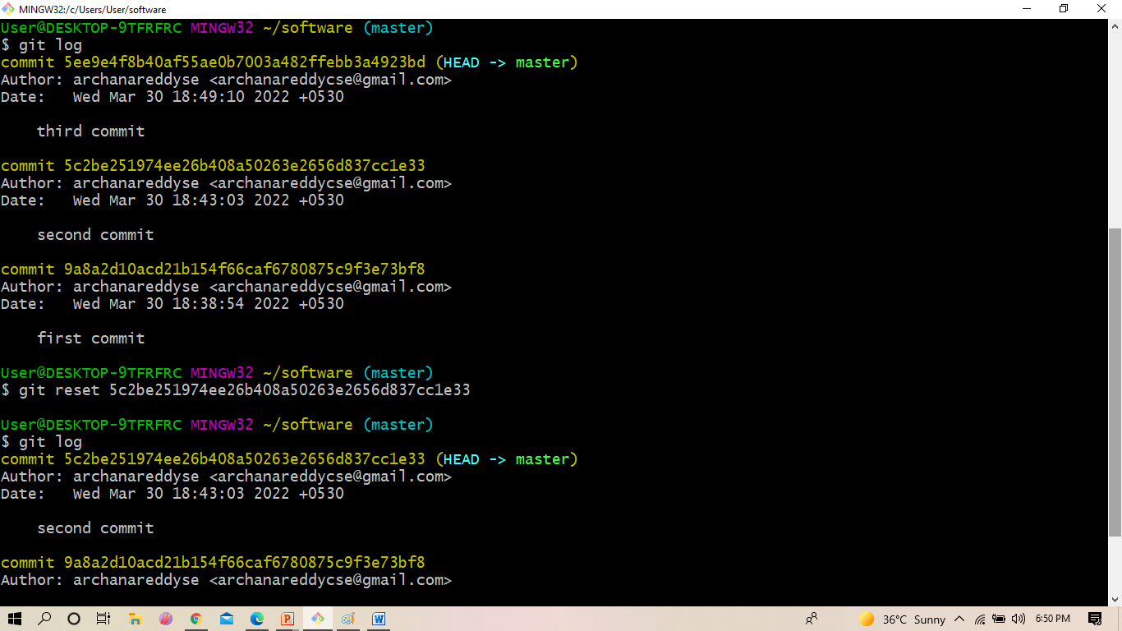
WORKING WITH GIT
$ git reset :
git reset is a powerful command that is used to undo local changes to the state of a Git repo.

Slide 24
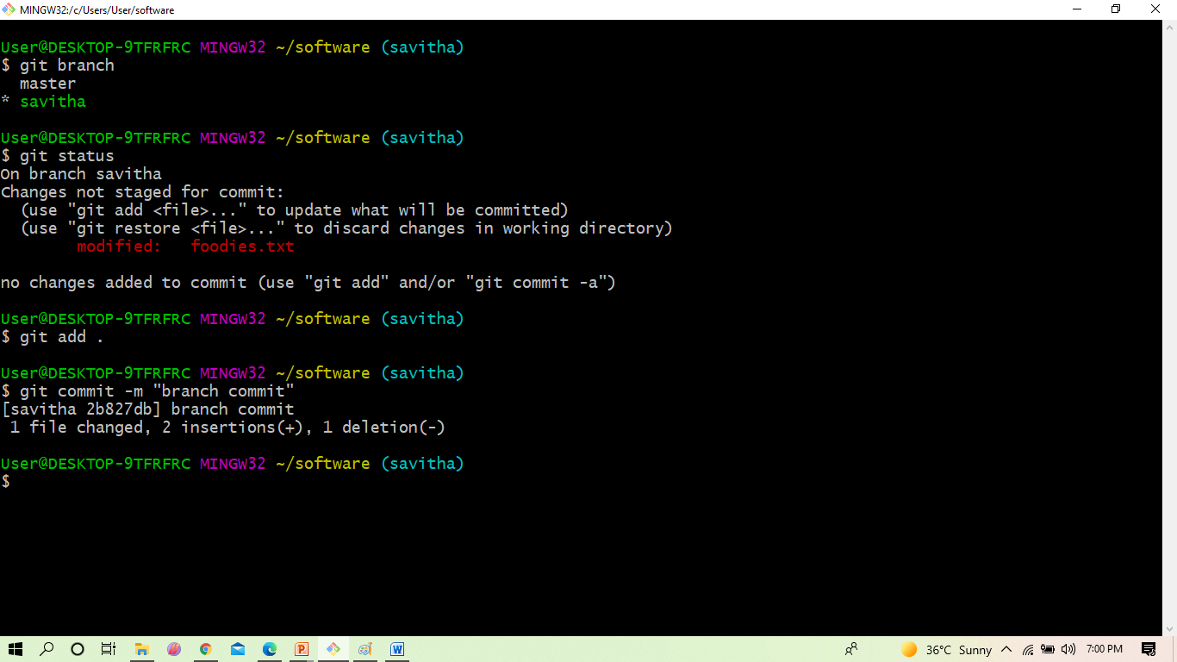
WORKING WITH GIT
$ git branch
A branch in Git is simply a lightweight movable pointer to one of these commits.
The default branch name in Git is master .

Slide 25
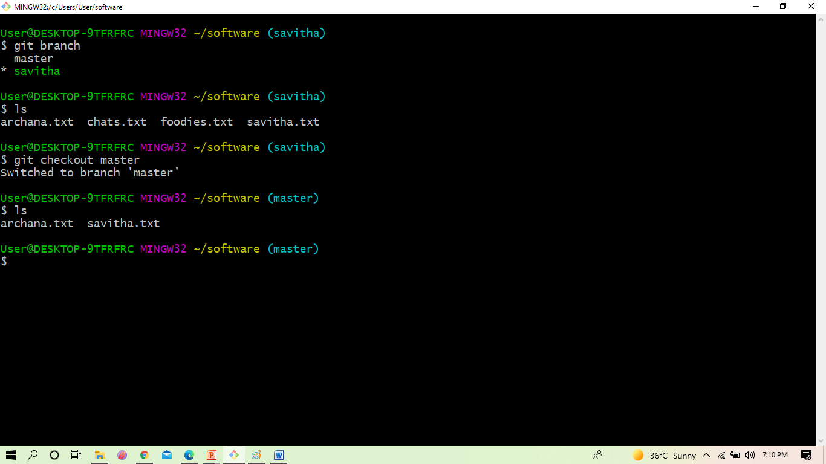
WORKING WITH GIT
$ git branch
The git checkout command lets you navigate between the branches created by git branch

Slide 26
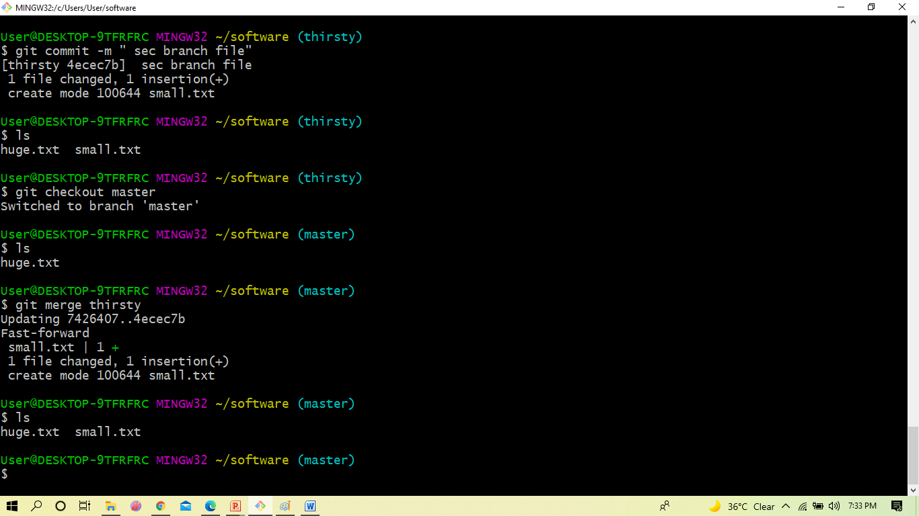
WORKING WITH GIT
$ git merge
Merging is Git's way of putting a forked history back together again

Slide 27
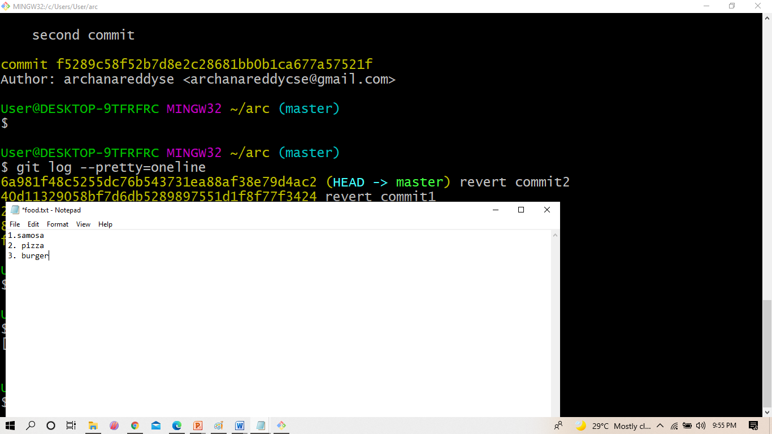
WORKING WITH GIT
Before reverting the file contains three lines ,where third line was added.

Slide 28
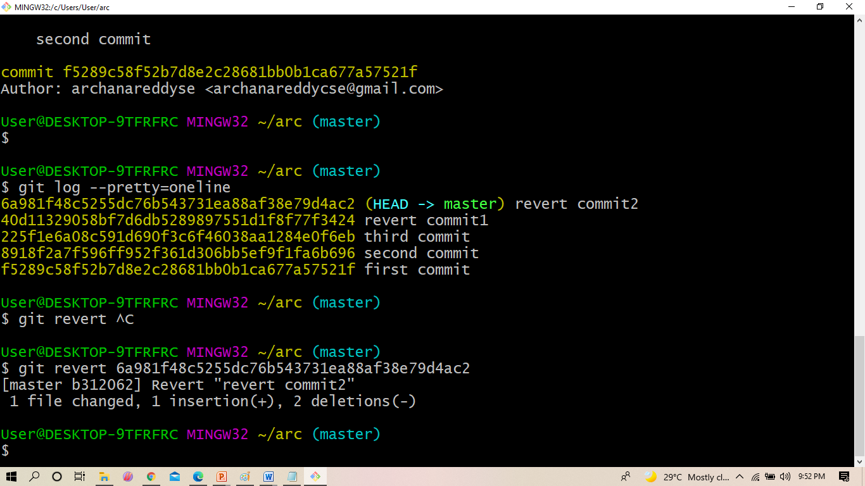
WORKING WITH GIT
$ git revert :
The git revert command is a forward-moving undo operation that offers a safe method of undoing changes

Slide 29
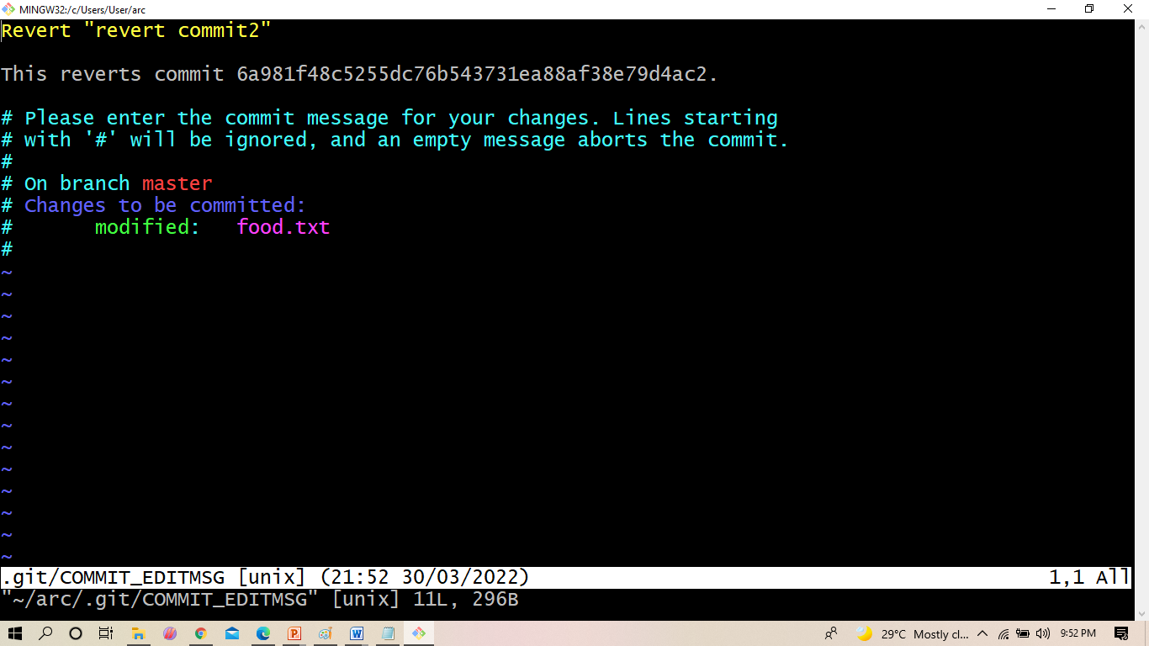
WORKING WITH GIT
After executing the revert command it display this screen
Press escape and colon q to quit from this window.

Slide 30
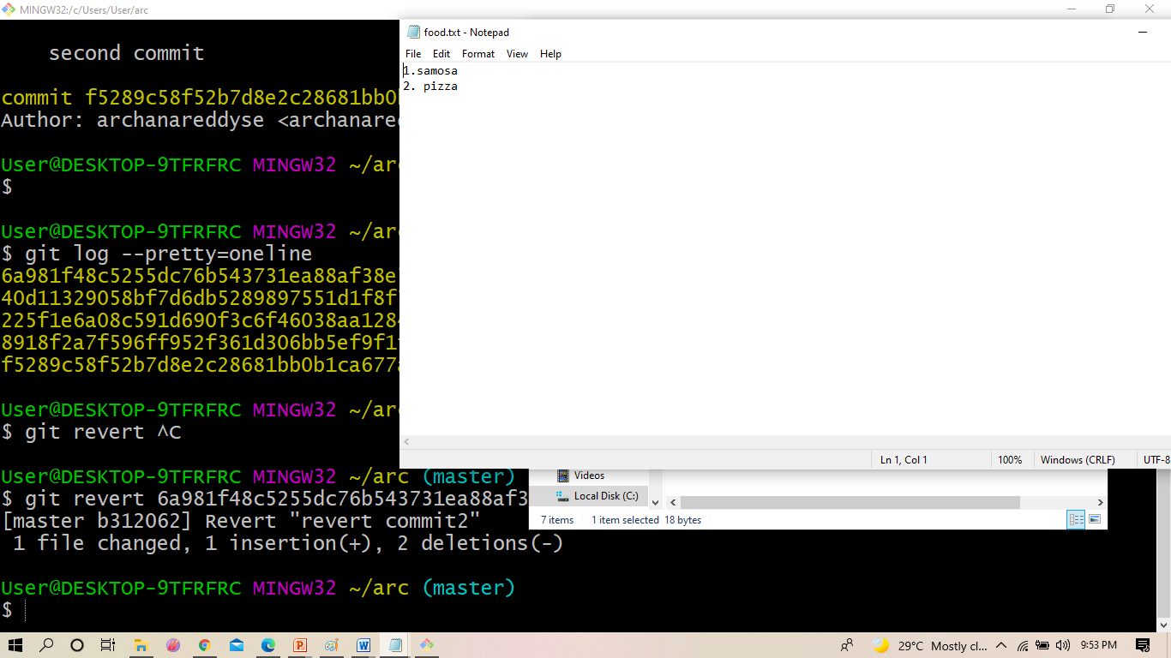
WORKING WITH GIT
Here we are done with the undo

Slide 31
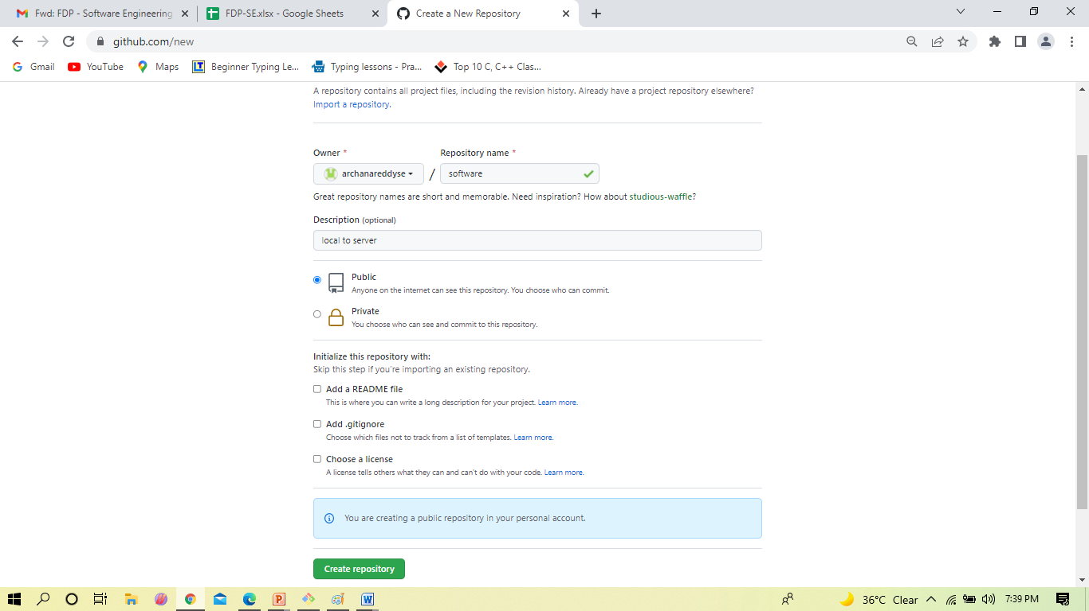
WORKING WITH GIT & GITHUB
Create new repository in git hub
Click on 🡪newrespository 🡪give reposistory Name 🡪enble on public 🡪click on create rep

Slide 32
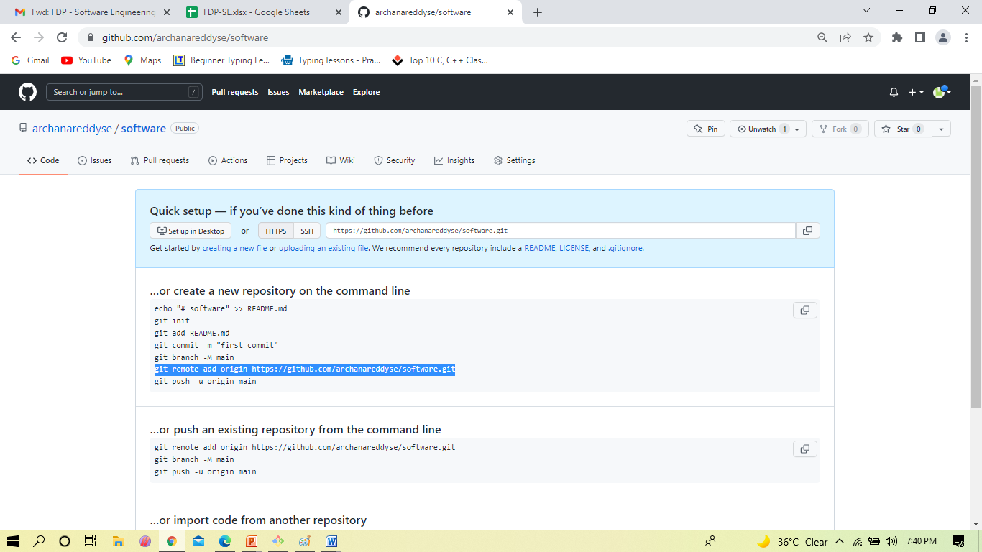
WORKING WITH GIT & GITHUB
Now copy the http code for pushing the files from local to server

Slide 33
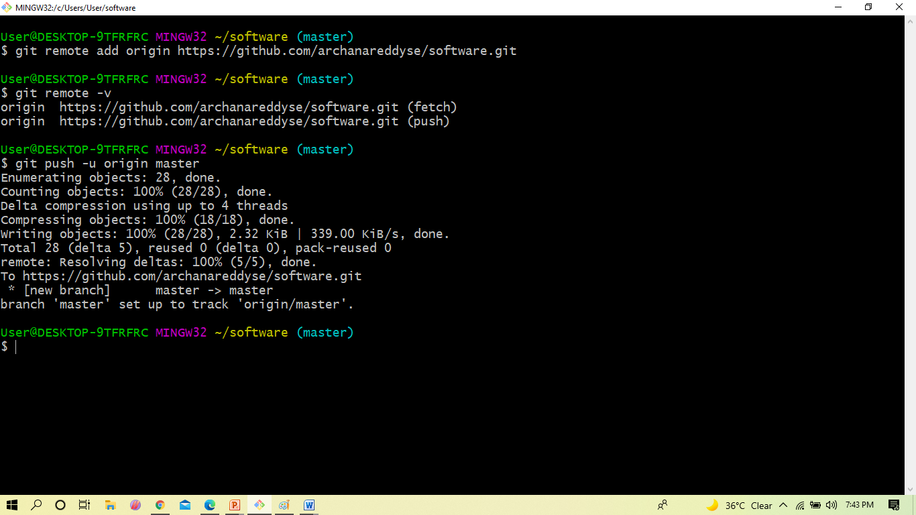
WORKING WITH GIT & GITHUB
$ git remote add origin
It centralises your source code to the other projects. It is developed based on Linux,
complete open source and make your code useful to the other git users.
$ git push
The git push command is used to upload local repository content to a remote repository

Slide 34
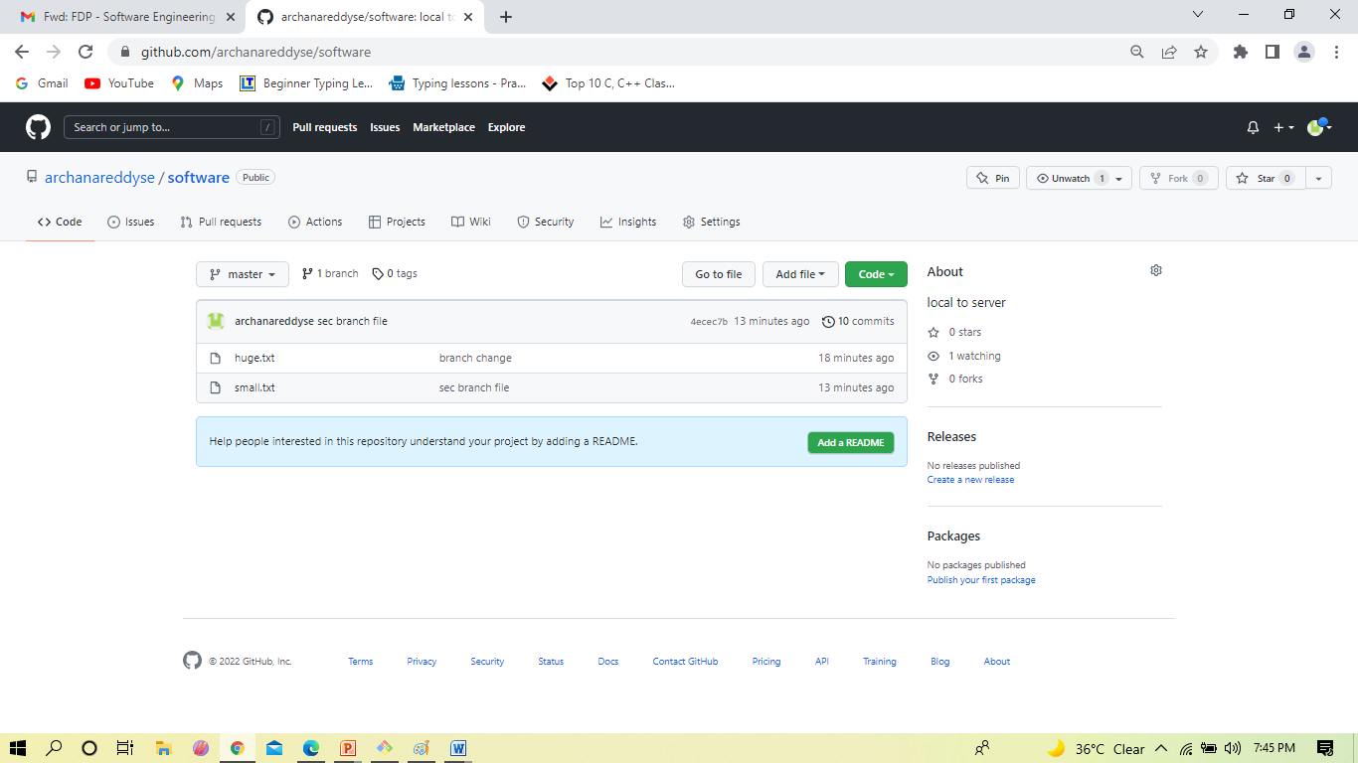
WORKING WITH GIT & GITHUB
After push from local system , go to github and refresh it
you see the your local files on server

Slide 35
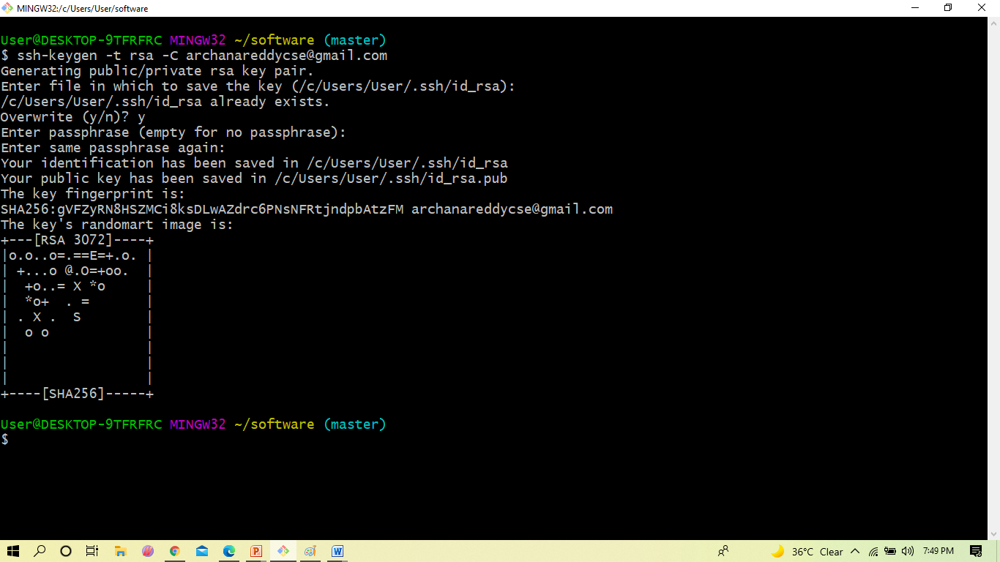
WORKING WITH GIT & GITHUB
Ssh-keygen is a tool for creating new authentication key pairs for SSH.

Slide 36
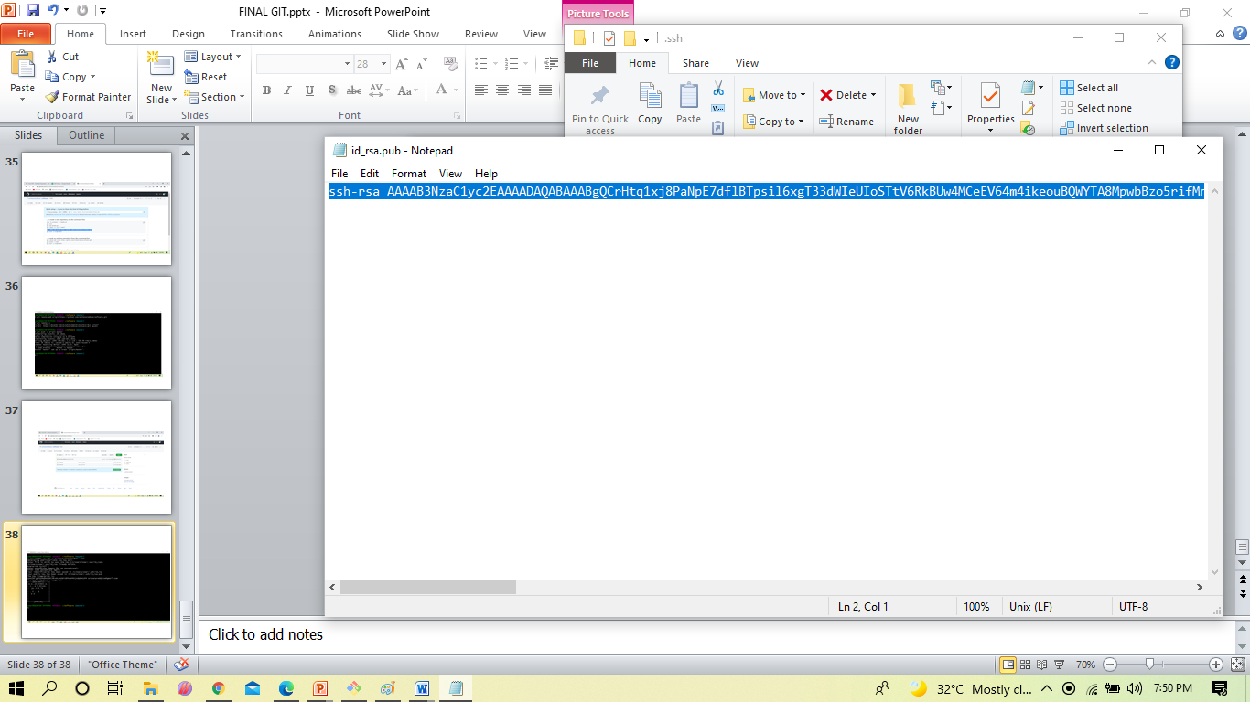
WORKING WITH GIT & GITHUB
Here you will getting rsa publickey ,select the key and paste in the github

Slide 37
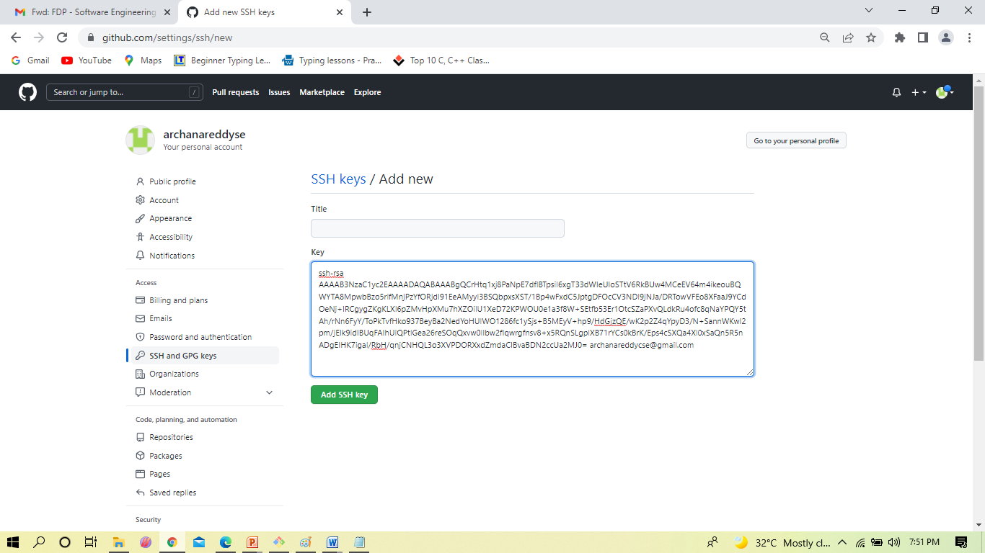
WORKING WITH GIT & GITHUB
Click on settings 🡪SSH & GPS keys 🡪new SSH KEYS 🡪Now paste on key text box 🡪
Click on add SSH key

Slide 38
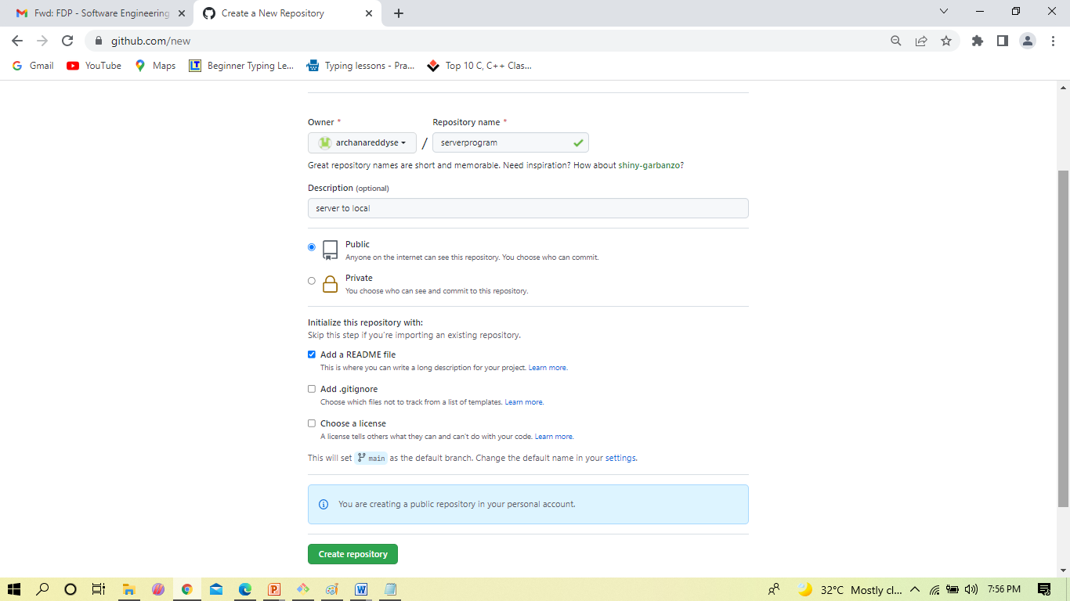
WORKING WITH GIT & GITHUB
Create a new repository 🡪public 🡪enable readme file 🡪click on repository

Slide 39
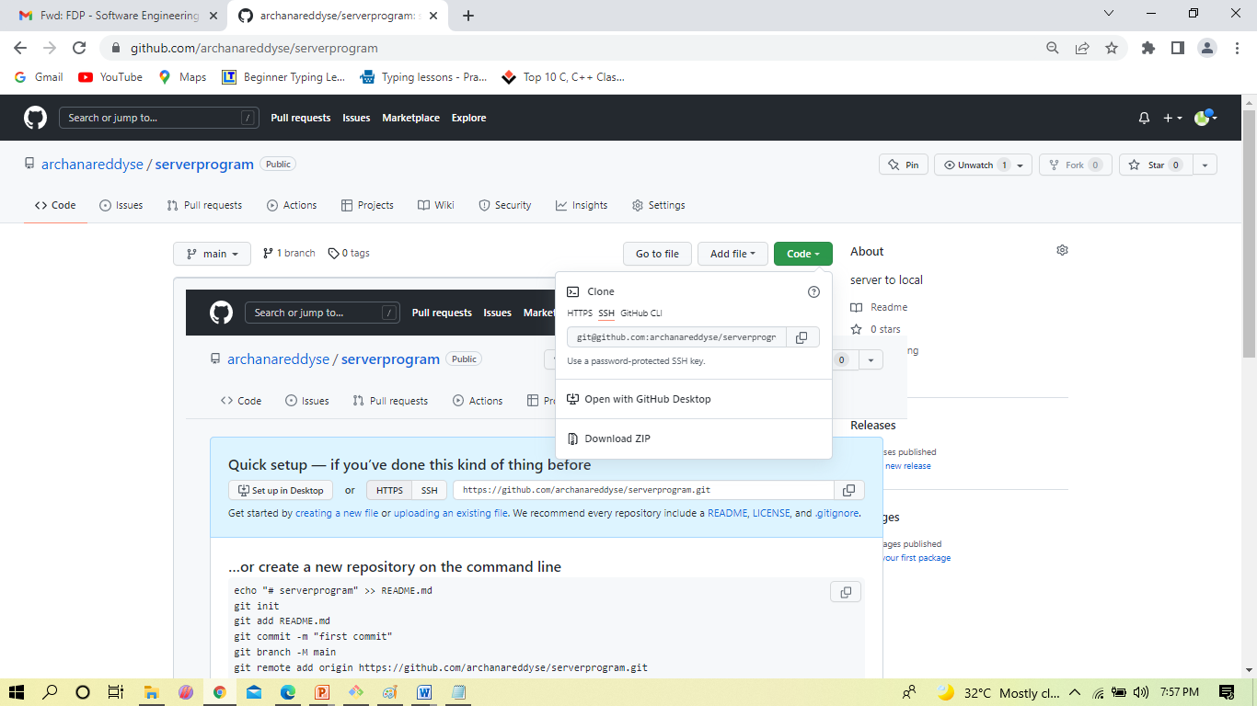
WORKING WITH GIT & GITHUB
Now copy the SSH KEY and paste in git

Slide 40
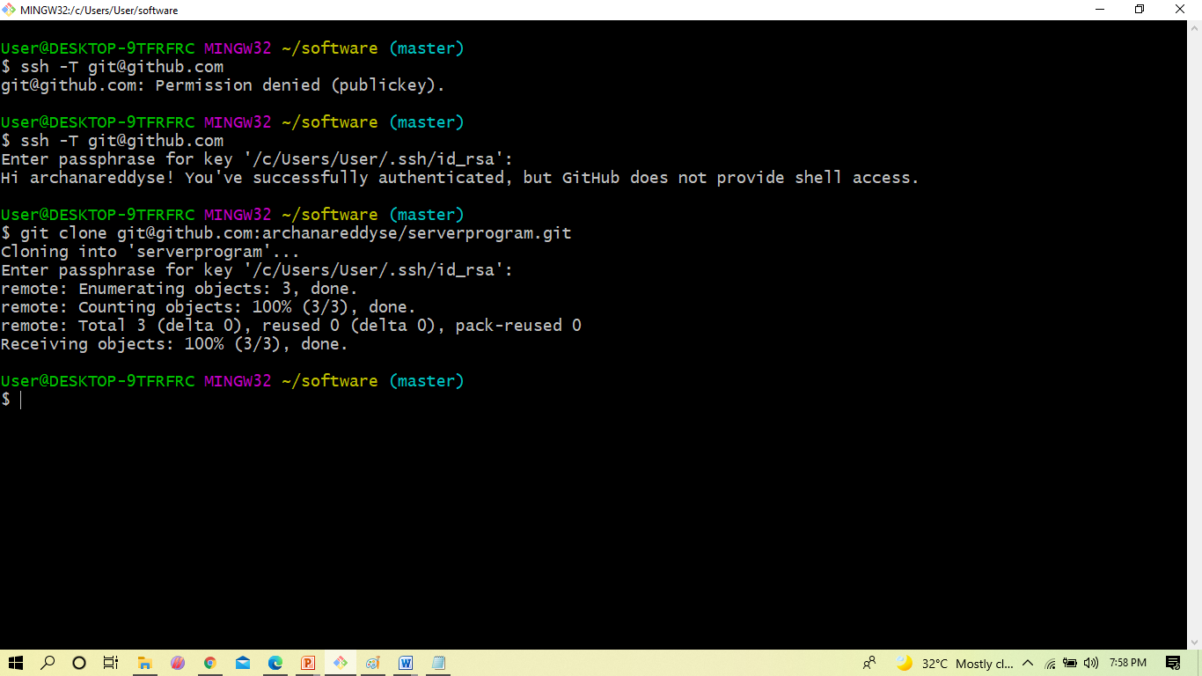
WORKING WITH GIT & GITHUB
$ git clone :
Git command line utility which is used to target an existing repository and create a clone, or copy of the target repository.

Slide 41
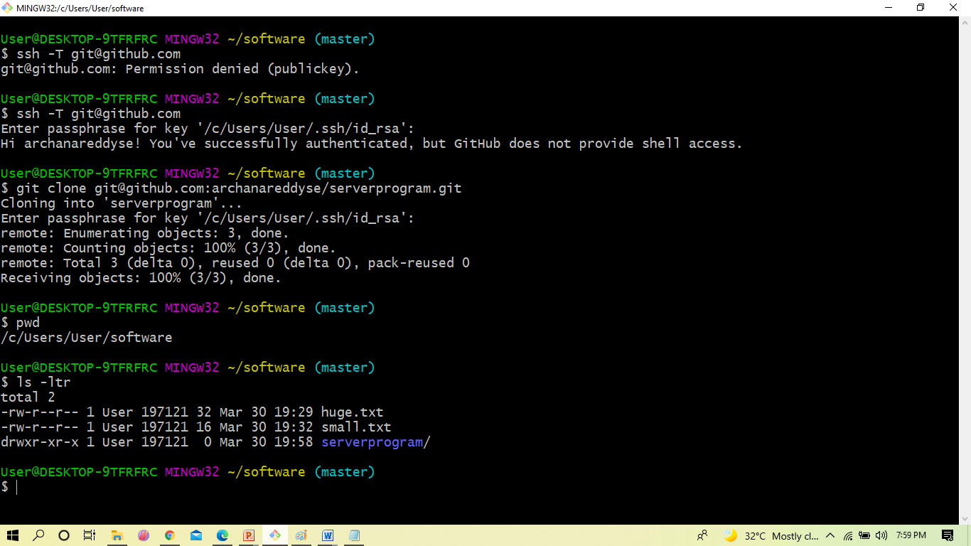
WORKING WITH GIT & GITHUB
$ ls –ltr
You can see it in the git

Slide 42
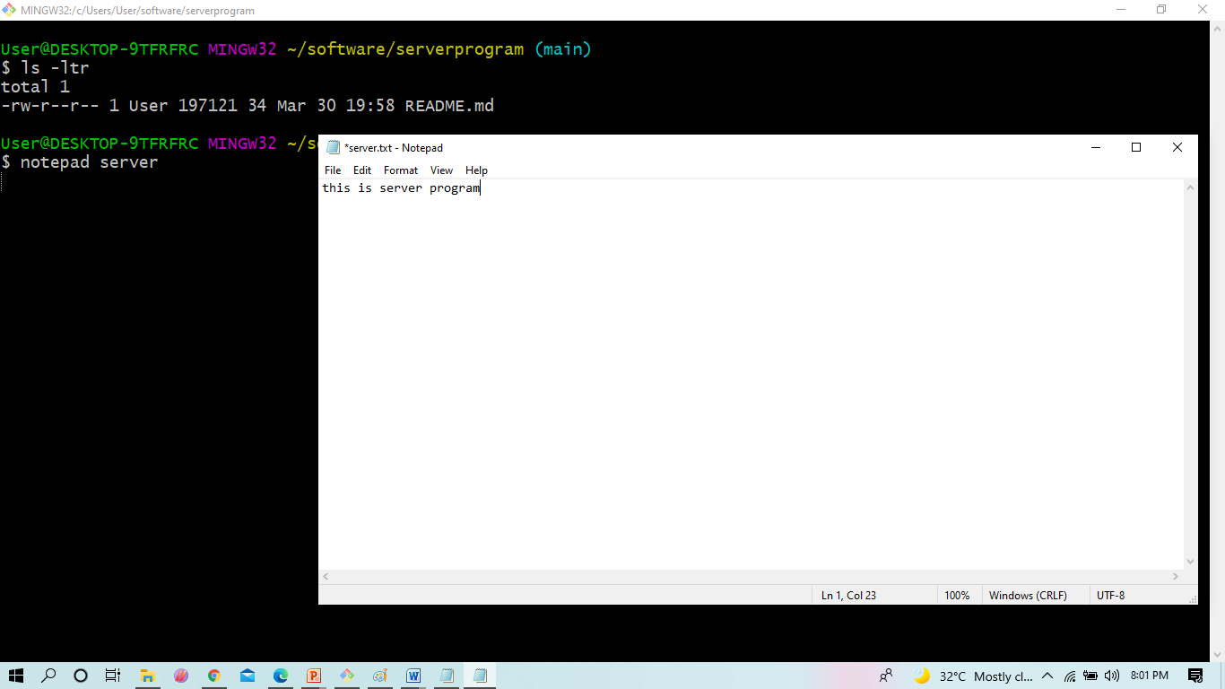
WORKING WITH GIT & GITHUB
Now get that directory and create the file

Slide 43
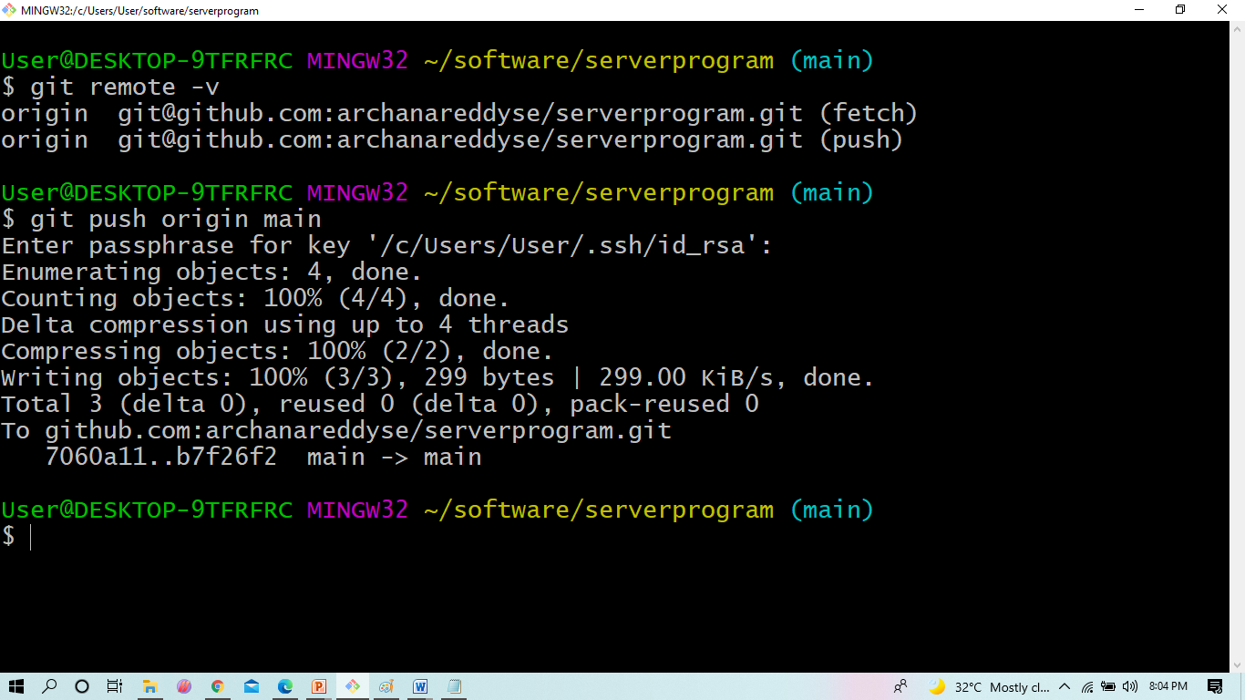
WORKING WITH GIT & GITHUB
$ push :
The git push command is used to upload local repository content to a remote repository.

Slide 44
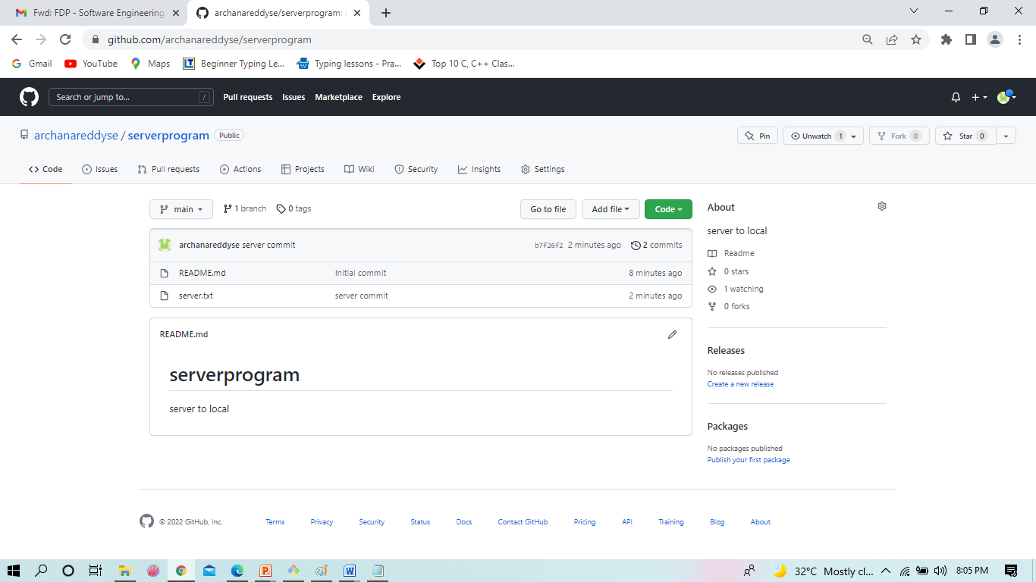
WORKING WITH GIT & GITHUB
Here we see the file which we have created

Slide 45
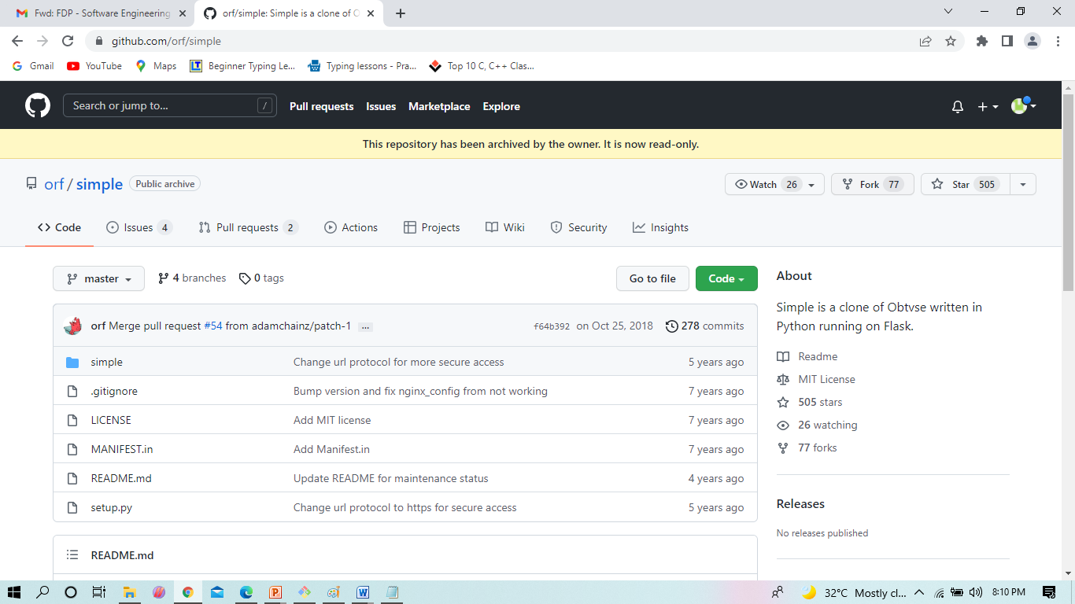
WORKING WITH GIT & GITHUB
A fork is a copy of a repository. Forking a repository allows you to freely experiment with changes without affecting the original project.
Here we forking the project from orf /simple

Slide 46
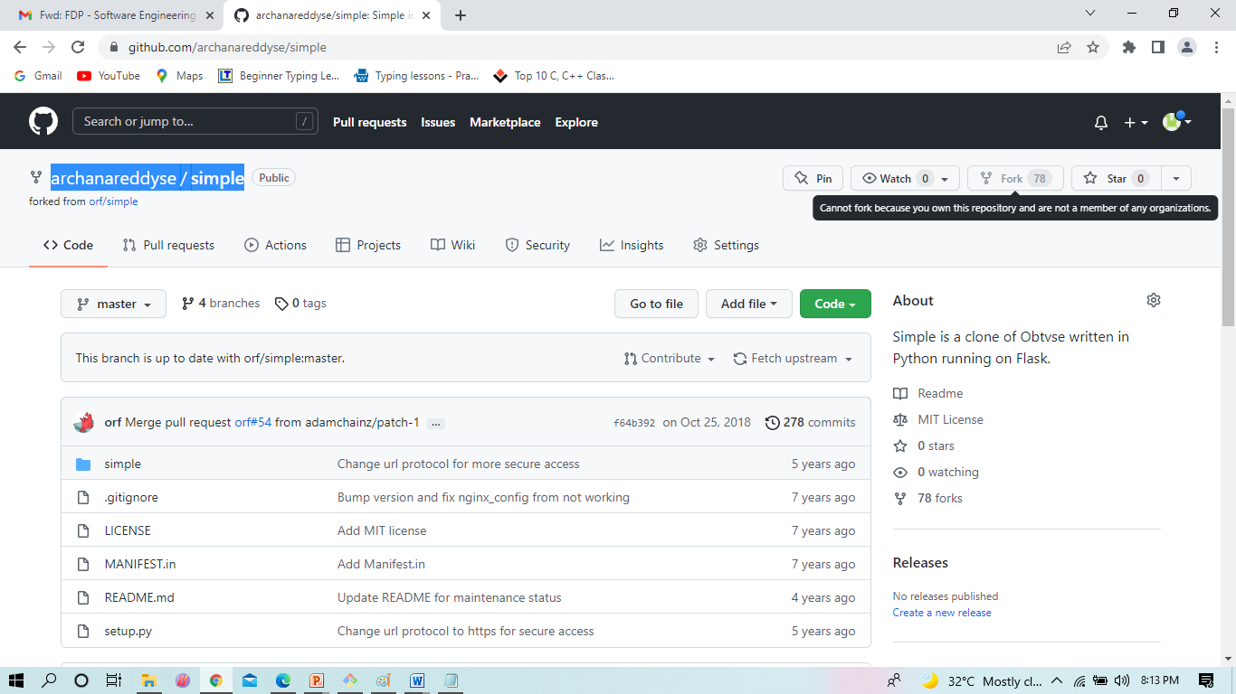
WORKING WITH GIT & GITHUB
The file called simple is in my login

Slide 47
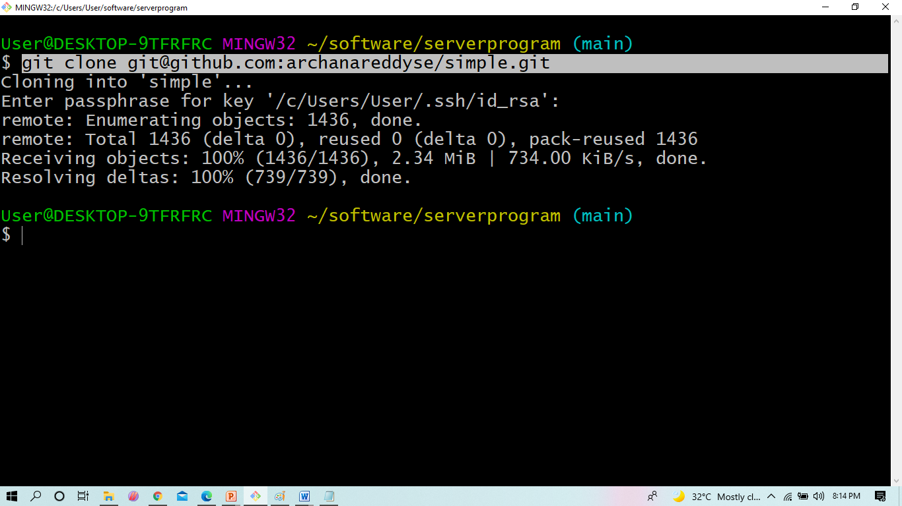
WORKING WITH GIT & GITHUB
We can on that file called simple by cloning into your local system

Slide 48
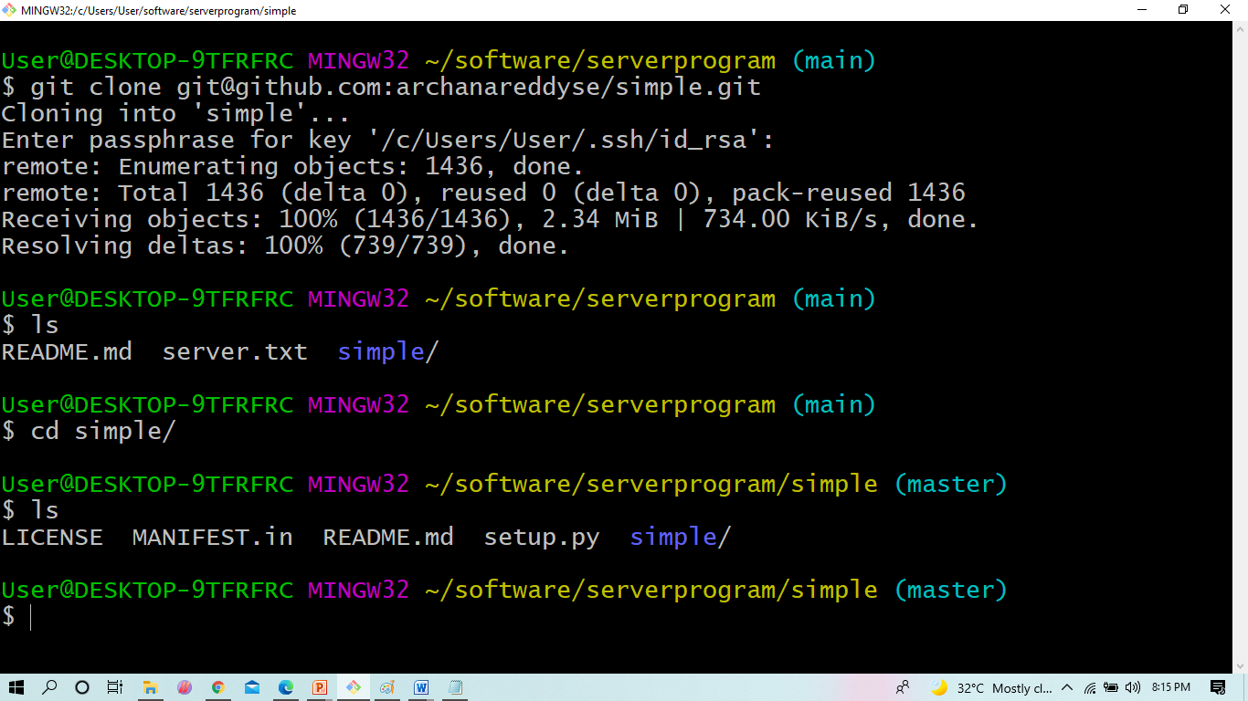
WORKING WITH GIT & GITHUB
We are in simple directory

